Slide 1
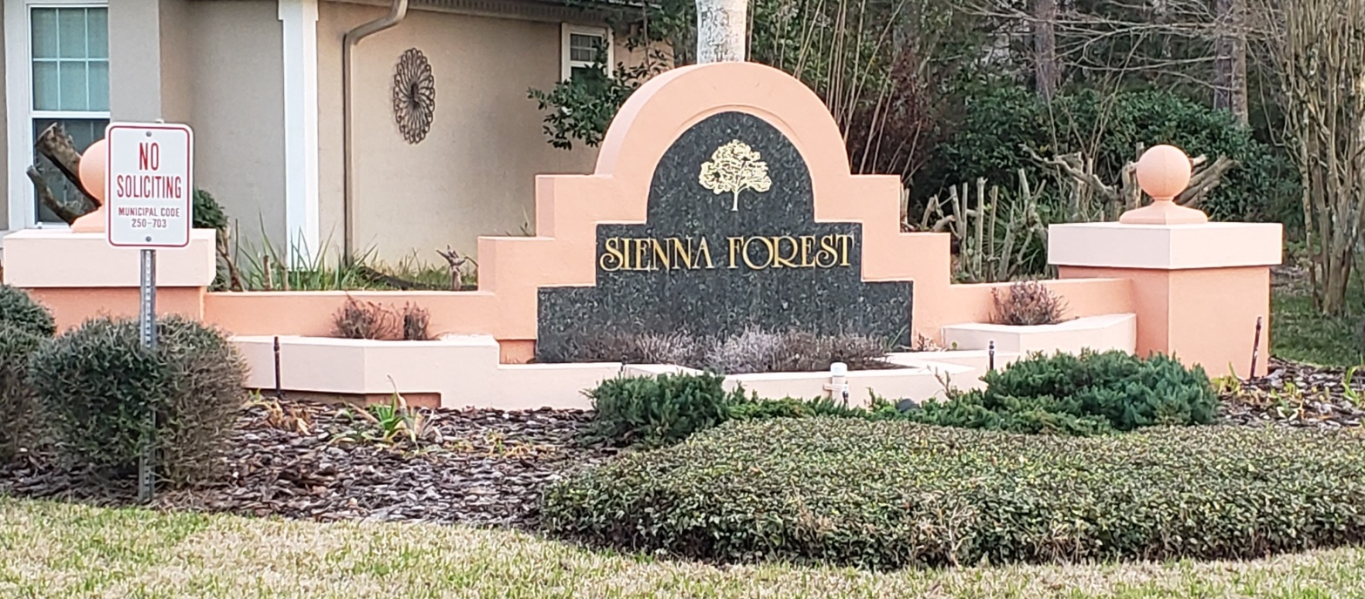
Sienna Forest Homeowners Association
1/30/23

Slide 2
Agenda
Welcome/Logistics - Kurt
Introductions
Be sure to sign in and make any updates so we can have an updated directory.
Budget for 2023 – Maxine
Election of 2023 Officials - Cheryl
Dinner on HOA/Cash Bar
What was done in 2022
Possible Future Needs
Covenants HOA Responsibilities
Covenants Homeowner Responsibilities
Swale/Drainage
Easements
Technologies - Aaron
Treasurer’s Report – Maxine
Assessments
Election - Cheryl
1 vote per lot

Slide 3
What was done in 2022
Signage
Swale Repair
CR Management
Testing Out
Website
Zoom Meetings

Slide 4

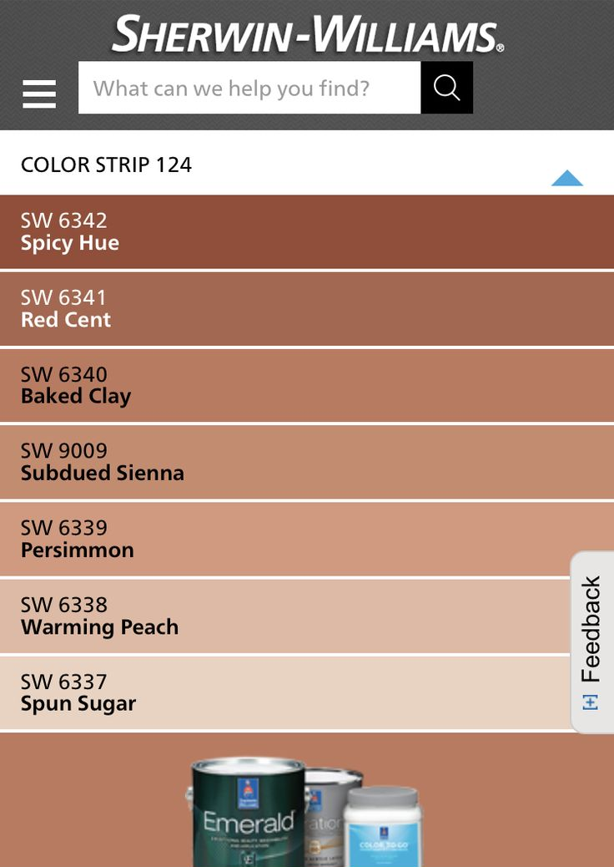

What is a Sienna Forest?

Slide 5
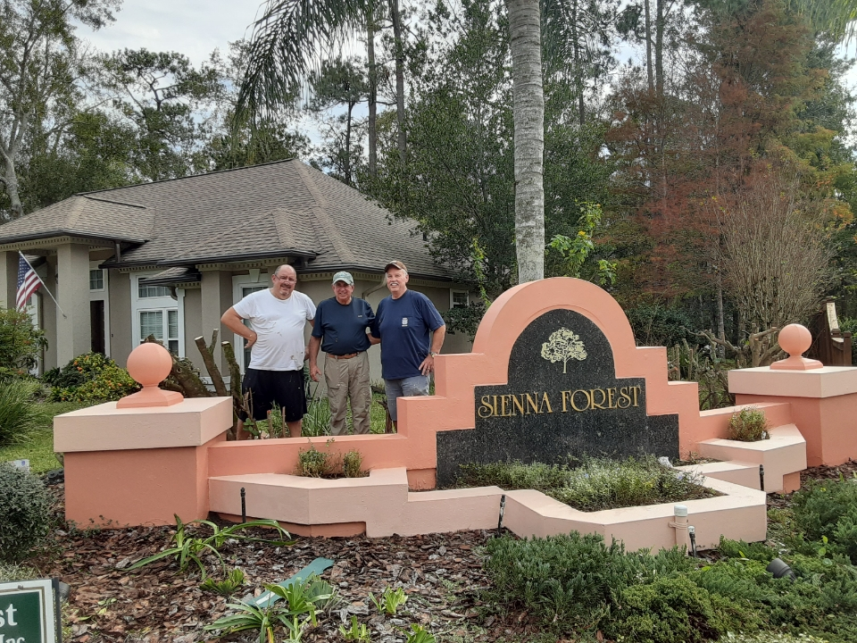
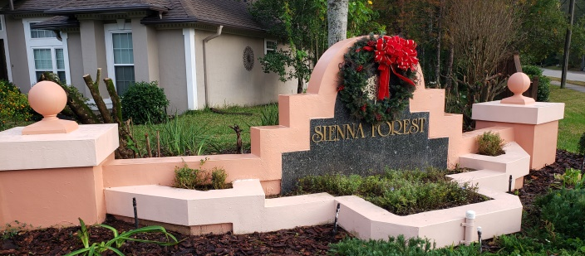
Signage Work 2022 - Residents
Painted
Maintain shrubs and tree trimming
Maintain garden
Decorate for the Holidays
Replaced lighting system and lights
Replaced Plug
Maintain sprinkler heads/system

Slide 6
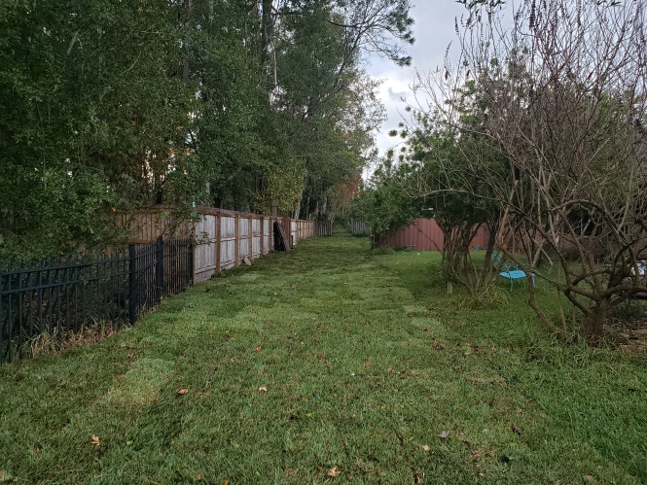
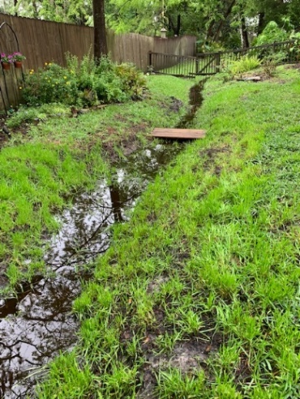
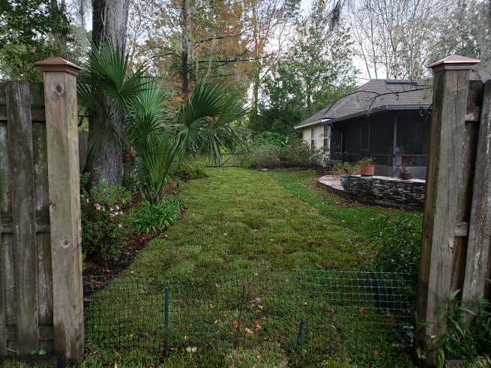
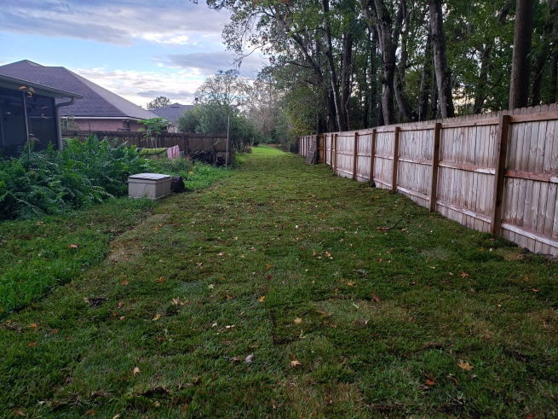
Swale Then/Now
Started 1/18/21
20 items on the punchlist from 8/2/21
Erosion
Standing Water
Dead sod
Estimate/Budget was $35,448.
$10,000 initial vendor – Spent $5,000
$25,500 Earthworks – Spent $23,801
To date we have spent $28,801
Drainage will be tested during the next heavy rain.

Slide 7
C&R
Testing the Insourcing of C&R Compliance
Saving $200/month
Possible outsourcing in 2023

Slide 8
Possible Future Needs
Drainage East side Tanya Ter East
Remove Brush around retention pond
Possible need to outsource C&R compliance
Technology expenses
Welcome baskets
Neighborhood events

Slide 9
Homeowner Responsibilities
Construction plans must be approved in writing by the ARC and HOA
ARC (Architectural Review Committee = Board of Directors and appointees)
Owners shall not construct any improvement on the easement areas, nor alter the flow of drainage, nor landscape such areas with hedges, trees or other landscape items that might interfere with the exercise of the easement rights.
Provide access to the HOA and its contractors to carry out its duties
Other covenants regarding
Animals, fences, outbuildings, exteriors, garages, driveways, antennas, fuel storage containters, waste recepticals, signs, mailboxes, laundry, window coverings
General maintenance of structures and landscaping

Slide 10
Easements
10 feet parallel to front and back lot lines
5 feet along each side lot line
36-37 and 37-38 have 12.5 foot easements on side lot lines
Easement over all portions of a lot (except where unit is constructed) to maintain, correct, and improve drainage of surface water. Including the right to cut trees bushes, shrubbery or make gradings
Restore surface to its original condition as practical, but not required to replace or repair fences, walls, structures, landscaping or other improvements that were located within the easement areas

Slide 11
HOA Responsibilities
Maintain Stormwater Management System installed by the Developer
STRWMD Permit No. 42-03101431IM
Maintain Retention pond
Maintain Drainage
Maintain Landscaping and signage at the entrance

Slide 12
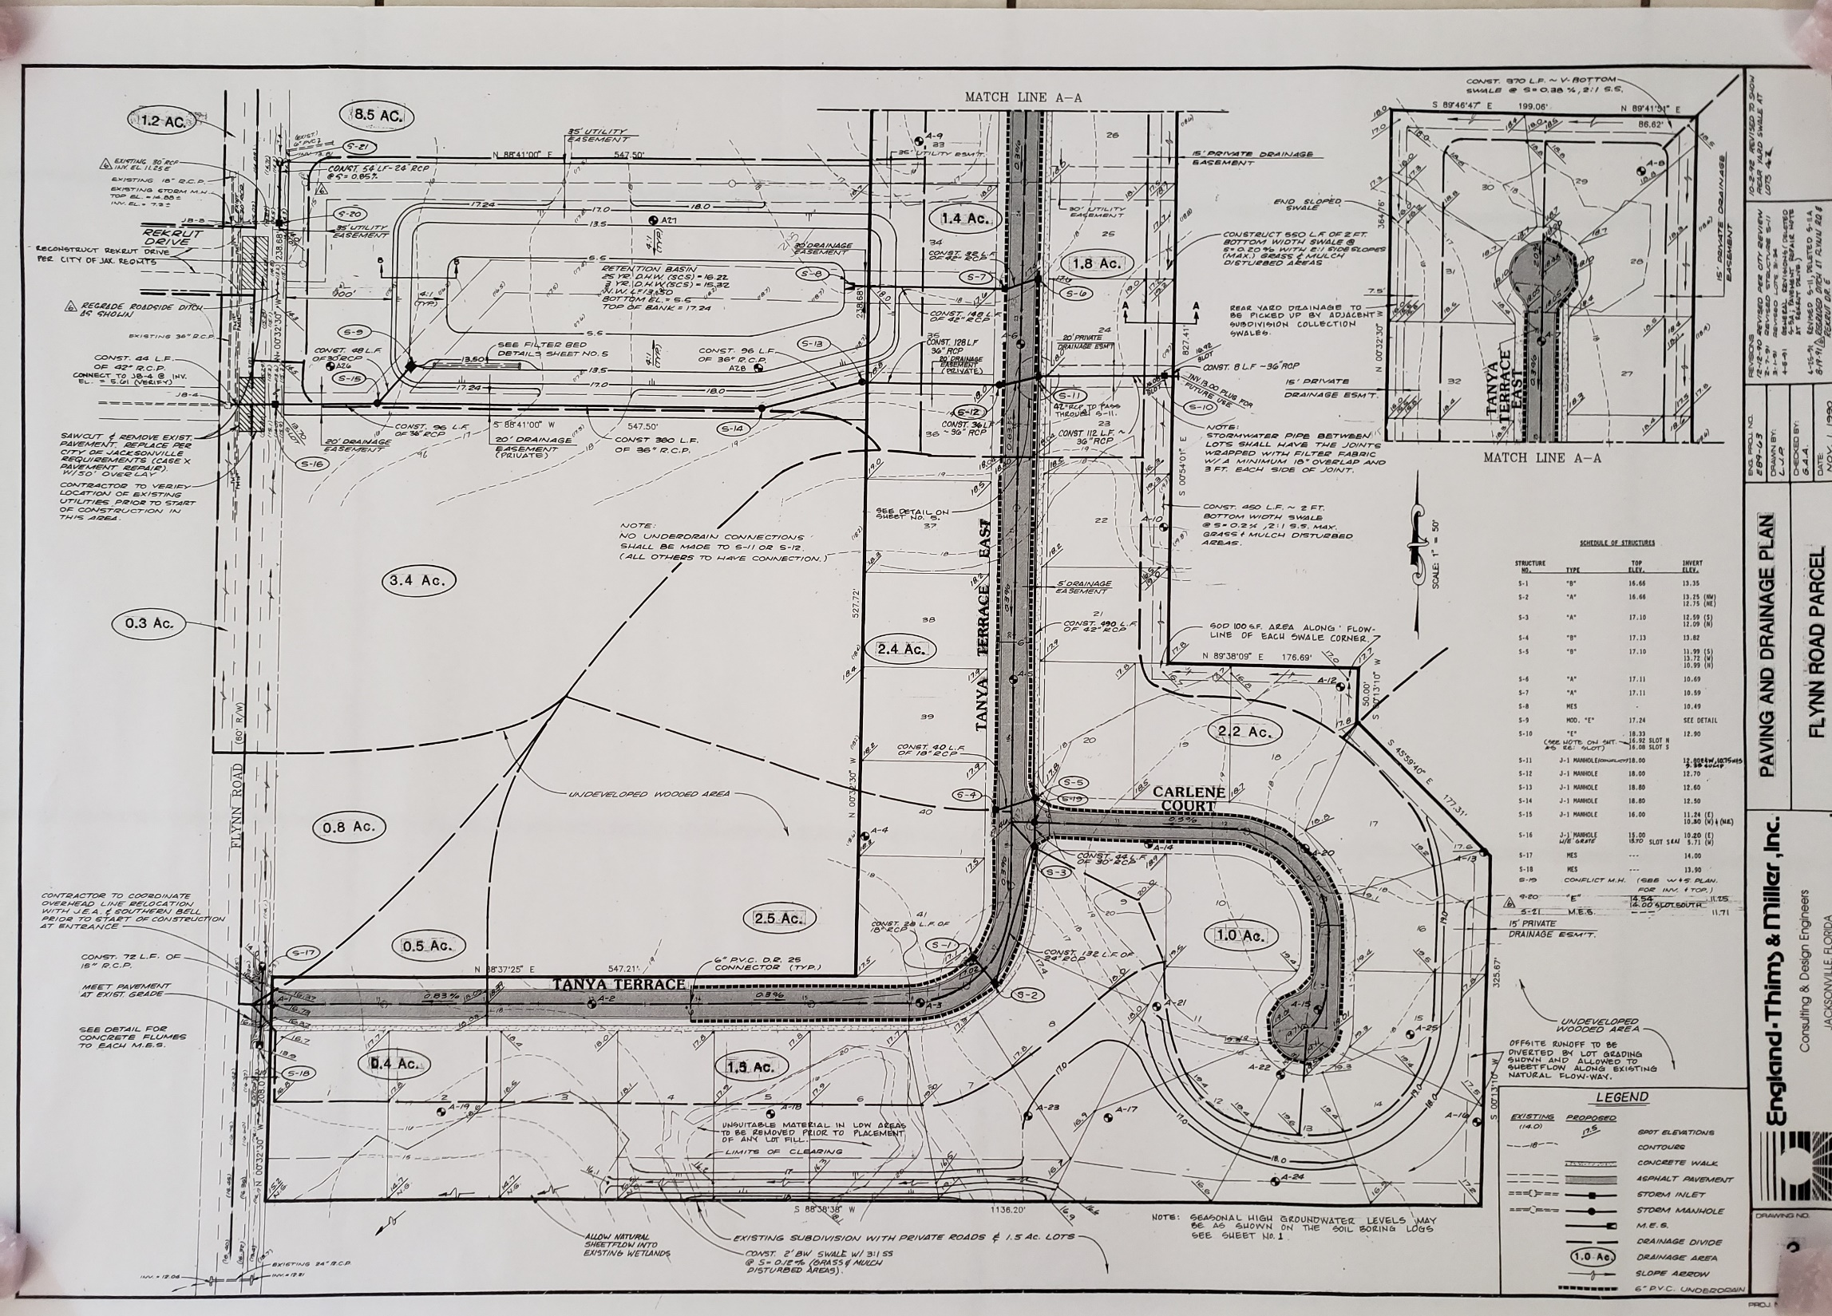

Slide 13
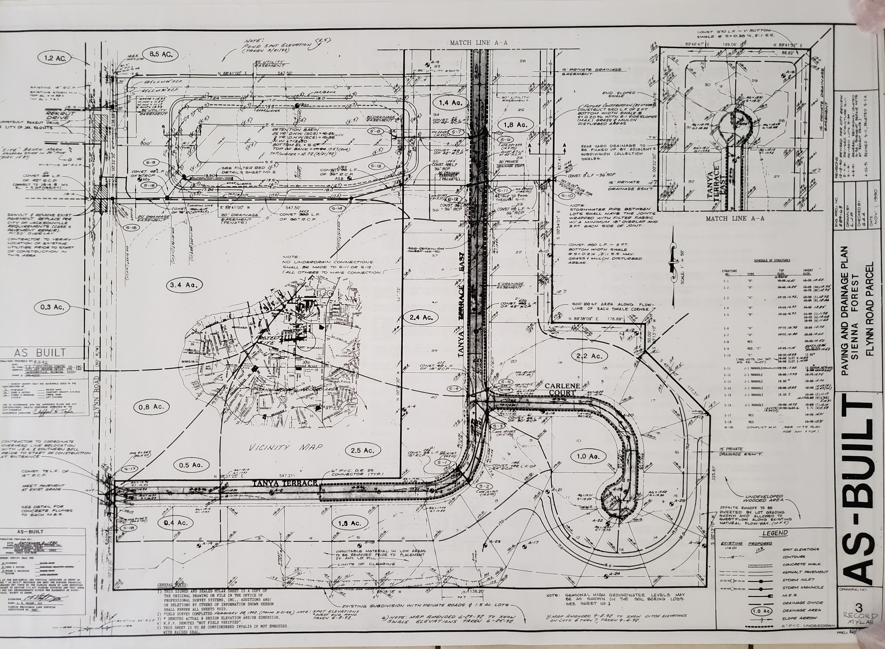

Slide 14
New Technologies
Website
Zoom
HOA Messenger

Slide 15
Assessments/Treasurer’s Report Source of Funds
Annual maintenance assessment
Letters went out $258.75 due 2/15 18% for late payment ($10,867.50 total).
Includes reserve amount for year .
15% cap in annual increase unless approved by members in attendance at meeting. 2022 Board voted to raise the fee ($1,417.50 added to the overall budget)
Increase working capital fund.
Special assessments
Must be approved by 2/3 of members who attend meeting for this purpose.
Assessments against a particular lot
Excise taxes that may be imposed

Slide 16
Treasurer’s Report 2022
2023 Annual Dues Revenue $10,867.50 (42 lots x $258.75)

Slide 17
Swale +
Estimate/Budget was $35,448.
$10,000 initial vendor – Spent $5,000
$25,500 Earthworks – Spent $23,801
To date we have spent $28,801

Slide 18
Treasurer’s Report 2022

Slide 19
Bylaws
Fiscal year = calendar year
Annual Meeting (Oct/Nov)
Member Meetings
Written notice
48 hour notice
Proxies – Members may vote in person or by proxy
Member Directory
Voting by majority of members present at meeting

Slide 20
Bylaws
Board of Directors = elected officers (President Treasurer and Secretary)
3 to 9 members
Nominees can come from the board or floor at annual meeting
1 year term
Vacancies during year can be filled by Directors/Board
Records
Books of Accounts
Minutes of the Proceedings
Membership Record (Directory)

Slide 21
Meetings
Regular Meetings
Annual Meeting Oct/Nov
Special Meetings
Called by President or 2 Directors with 3 days prior notice
Quorum
Majority of attendees or 2/3 where expressly required
Meetings in person are not required

Slide 22
Regular Officers
President
Presides at meetings
Carries our orders and resolutions
Signs all legal documents
Vice President
Acts in place of the president
Secretary
Records votes and keeps minutes
Keeps corporate seal
Gives notice of meetings
Keeps Membership Records
Treasurer
Keeps books
Signs checks (with President)
Carries out Audits requested by membership

Slide 23
Election Results - Cheryl

